Slide 1
B.SC. (HONS.) IN COMPUTER SCIENCE (SPECIALISATION IN CLOUD COMPUTING AND BIG DATA)
Presentation by:
Mohamed Rahman Shareff S

Slide 2

Welcome to the Cyber World
We are the Developers of the future….

Slide 3

What is BSc Hons Computing?
This course allows you to develop technical and practical skills in a range of computing subjects including computer technology, database design, internet technology, programming, multimedia, interactive systems design and systems development.

Slide 4

What is Cloud Computing ?
Cloud computing is the on-demand availability of computer system resources, especially data storage and computing power, without direct active management by the user. The term is generally used to describe data centre's available to many users over the Internet.

Slide 5

What is big data ?
Big data is a field that treats ways to analyse, systematically extract information from, or otherwise deal with data sets that are too large or complex to be dealt with by traditional data-processing application software.

Slide 6

What are the uses ?
“Big Data” refers to the large sets of data collected, while “Cloud Computing” refers to the mechanism that remotely takes this data in and performs any operations specified on that data. Cloud Computing providers often utilize a “software as a service” model to allow customers to easily process data.

Slide 7

What are the opportunities we have ?
Information security analyst
Software Engineer
Data Analyst
Data Scientist
Back-end developer
Front-end developer
Big data developer
Cloud Computing & Big Data program

Slide 8

Information security analyst
Information security analysts install software, such as firewalls, to protect computer networks. Information security analysts plan and carry out security measures to protect an organization's computer networks and systems. Their responsibilities are continually expanding as the number of cyberattacks increases.
Job Outlook, 2018-28: 32% (Much faster than average)
Number of Jobs, 2018: 112,300

Slide 9

Software engineer
Software engineering is the systematic application of engineering approaches to the development of software. Software engineering is a computing discipline.

Slide 10

Data analyst
Data analysis is a process of inspecting, cleansing, transforming and modelling data with the goal of discovering useful information, informing conclusions and supporting decision-making.

Slide 11

Data scientist
Data science is an inter-disciplinary field that uses scientific methods, processes, algorithms and systems to extract knowledge and insights from many structural and unstructured data. Data science is related to data mining, machine learning and big data.

Slide 12
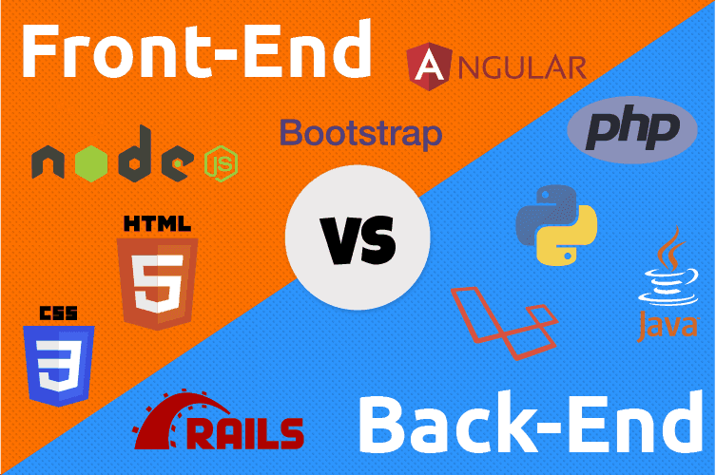
Front end development & Back end development
Front-end web development is the practice of converting data to a graphical interface, through the use of HTML, CSS, and JavaScript, so that users can view and interact with that data.
Back-end Development refers to the server-side development. ... Backend developer focuses on databases, scripting, and the architecture of websites. Code written by back-end developers helps to communicate the database information to the browser.

Slide 13

Big data developer
Big Data Developer is the one who loves programming. He/she needs to have a knowledge of core Java, SQL, and any scripting language along with good interpersonal skills. Big data developer is responsible for the actual coding or programming of Hadoop applications. This role is similar to that of a Software Developer.

Slide 14
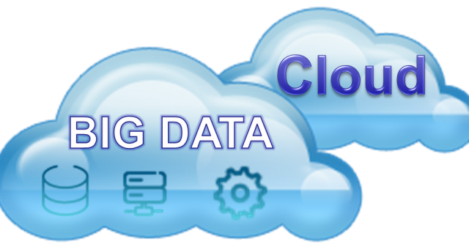
Cloud computing & Bigdata program
They can often view and query large data sets much more quickly than a standard computer could. Essentially, “Big Data” refers to the large sets of data collected, while “Cloud Computing” refers to the mechanism that remotely takes this data in and performs any operations specified on that data.

Slide 15

What kind of salaries are there ?

Slide 16
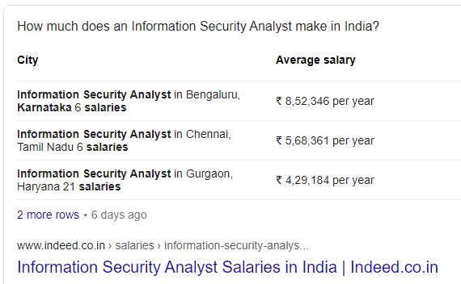
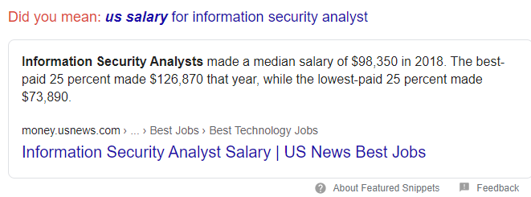
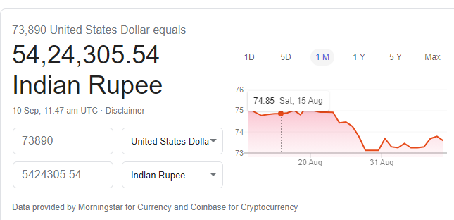
Information security analyst

Slide 17
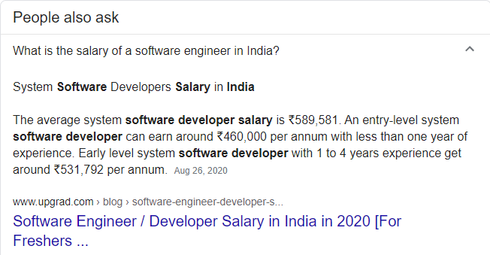
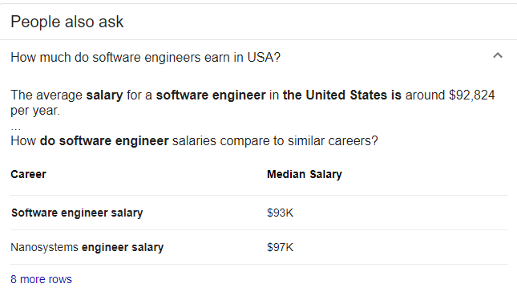
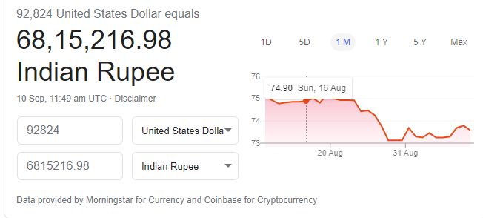
Software engineer

Slide 18
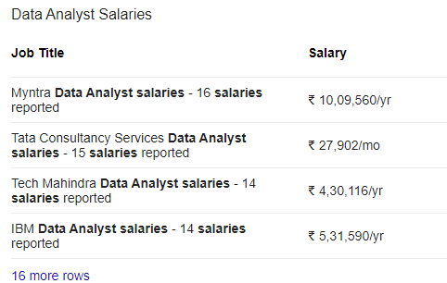
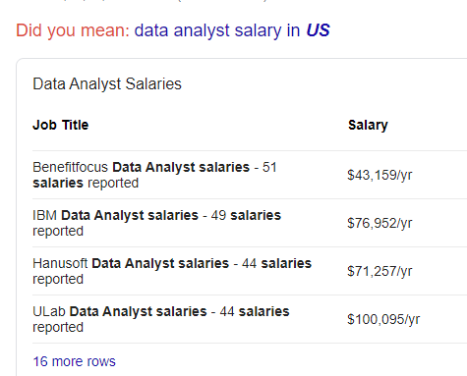
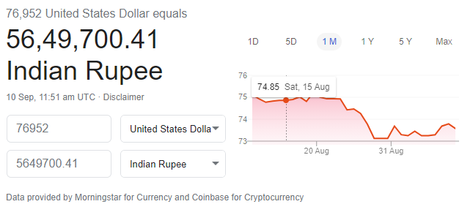
Data analyst

Slide 19
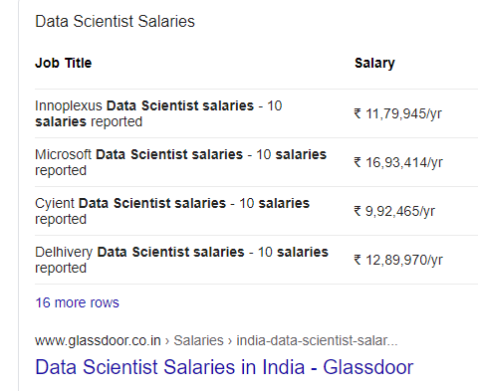
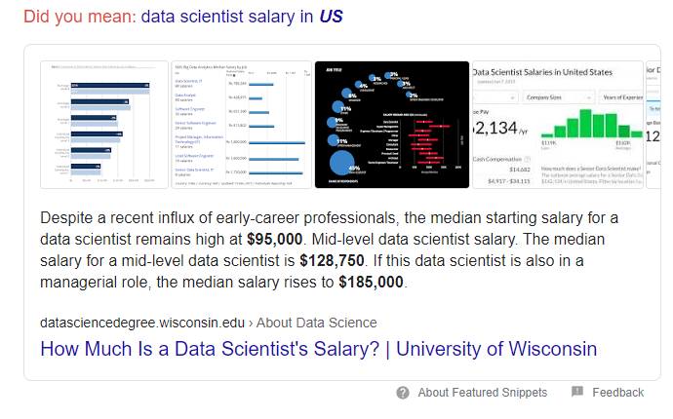
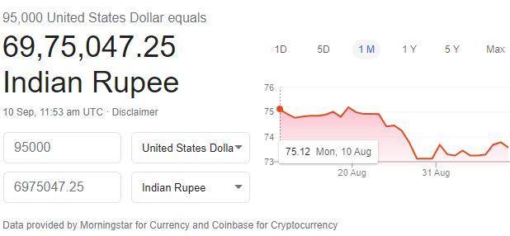
Data scientist

Slide 20
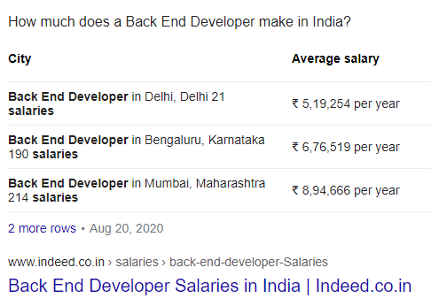
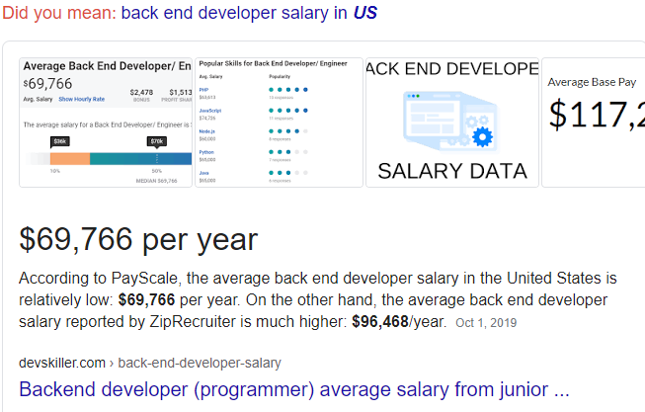
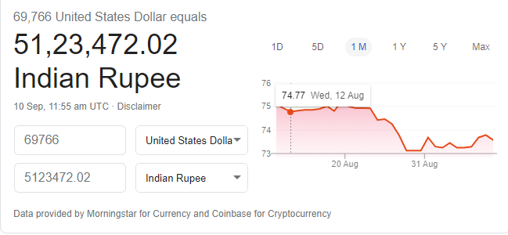
Back end developer

Slide 21
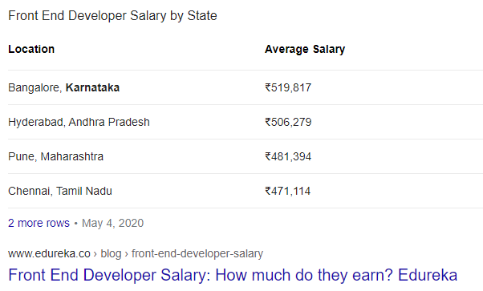
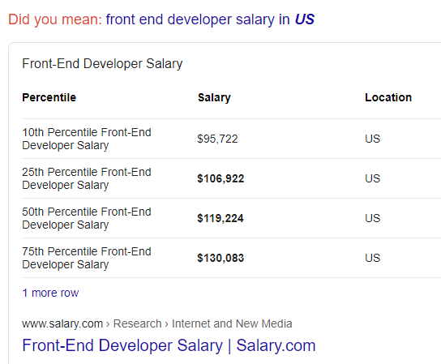
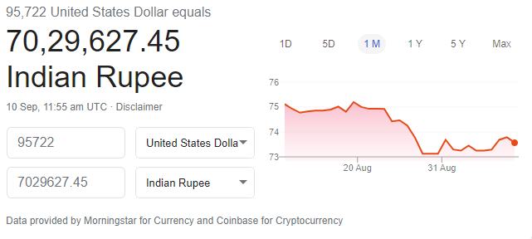
Front end developer

Slide 22
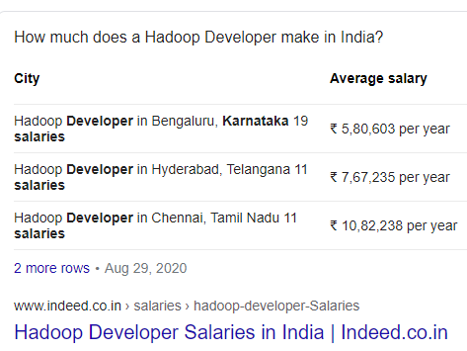
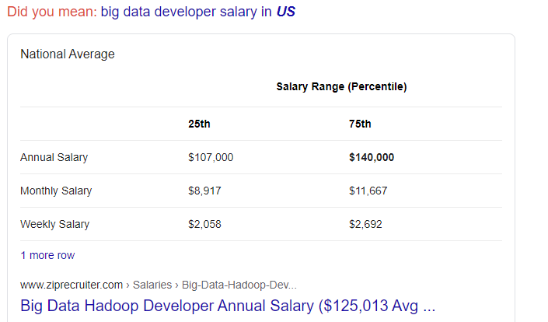
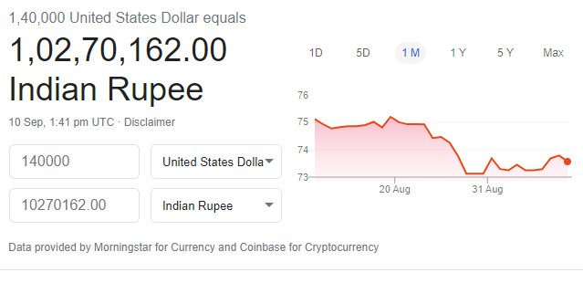
Big data developer

Slide 23
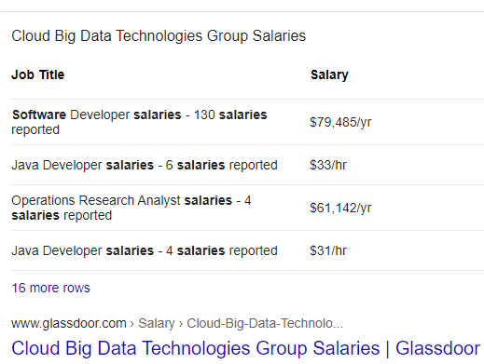
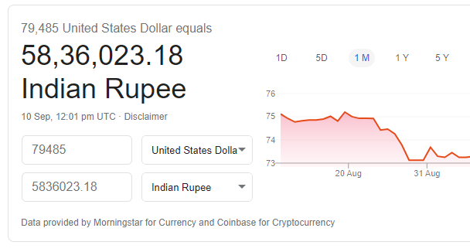
Cloud computing & Bigdata

Slide 24
Additional Opportunities ?
Application Analyst. Application analysts are responsible for the administration, monitoring, and maintenance of software infrastructures and applications. ...
Database Administrator. ...
Games Developer. ...
Information Systems Manager. ...
IT Consultant. ...
Systems Analyst. ...
Web Designer. ...

Slide 25

Which is the best platform for searching jobs ?
LinkedIn is a social network that focuses on professional networking and career development. You can use LinkedIn to display your resume, search for jobs, and enhance your professional reputation by posting updates and interacting with other people.

Slide 26

What can we do with in LinkedIn ?
Look for Jobs. Under the “Jobs” tab, you can search for jobs, save your searches and set up job alerts (allowing LinkedIn to do the work for you). ...
Get Found By Recruiters and Employers. ...
Use It As a Research Tool. ...
Expand Your Network and Connections. ...
Build Your Credibility and Personal Brand.

Slide 27
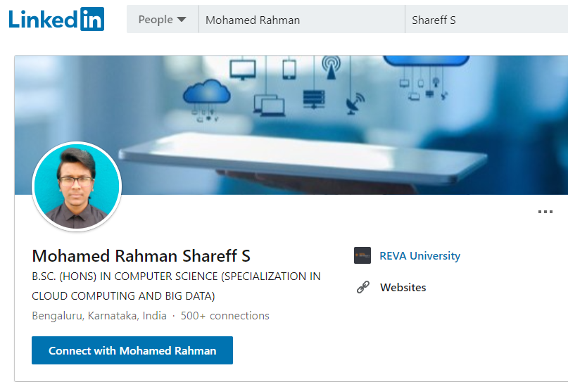
Just make a profile in LinkedIn…

Slide 28

What Next's ?
Create a strong profile and complete all the sections of your profile and you are done. Put good bio section including who you are and what are you up to as well include you skills and capabilities in last. You can also attach the CV of yours.

Slide 29
Conclusion :
We have more opportunities
We have good salaries
We have good life
Don’t waste it my friends, we are not normal persons we are the developers of the future….☺
Note : The pictures and information's are taken from google

Slide 30

About me :
Mohamed RAHMAN Shareff s
+91 7695821235
LinkedIn : https://www.linkedin.com/in/rahman07

